Slide 1
PLAYER PERFORMANCE PREDICTION USING RIDGE AND LASSO REGRESSION
Submitted by
J RAKSHITHA 2520090212
N CHARISHMA 2520090214
J PRAGATHI 2520090216
Under the guidance of
Dr. HARITHA
Department of CSIT

Slide 2
CONTENTS
01 Abstract
02 Introduction
03 Problem Statement
04 Motivation
05 Objectives
06 Literature Survey
07 Existing System
08 Proposed System
09 System Architecture
10 Methodology
11 Technology Stack
12 System Modules
13 Dataset, Preprocessing
14 Algorithms Used
15 Evaluation Metrics
16 Implementation, Results
17 Advantages, Applications
18 Limitations, Future Scope
19 Conclusion
20 References

Slide 3
ABSTRACT
Machine Learning can be used to analyze sports data and predict player performance.
Our project predicts player performance using Ridge Regression and Lasso Regression.
Historical player statistics such as matches, runs, batting average, strike rate, wickets, age and experience are used as input features.
The data is preprocessed by handling missing values, removing duplicates, encoding categorical data and scaling numerical features.
EDA is performed to understand relationships between different player attributes.
Ridge and Lasso add a penalty term to ordinary least squares, which controls model complexity and reduces overfitting.
Both models are evaluated using MAE, MSE, RMSE and R² Score and their results are compared.
The project aims to help coaches and sports analysts make data-driven decisions.

Slide 4
INTRODUCTION
Sports analytics is increasingly using Machine Learning to analyze player data.
Every match generates a large amount of data: runs, wickets, averages, strike rates, fitness and experience.
Player performance can be predicted using historical statistics, and ML helps identify patterns that may not be easily identified manually.
Regression is a supervised learning technique that predicts a continuous value, so it suits performance prediction.
Plain linear regression overfits when features are many or correlated, so we use regularized regression.
Our project focuses on Ridge Regression (L2 penalty) and Lasso Regression (L1 penalty).
Project flow: Data Collection → Preprocessing → EDA → Feature Engineering → Model Training → Evaluation → Comparison
The final system predicts player performance and identifies important performance factors.

Slide 5
PROBLEM STATEMENT
Existing problem:
Player performance is usually judged by manual observation, experience of selectors and simple averages.
It is difficult to forecast how a player will perform in upcoming matches.
Limitations / challenges:
Player statistics have many features and several of them are correlated (for example matches and runs).
Ordinary linear regression becomes unstable and overfits on such data, giving poor results on new data.
Not clear which statistics actually influence performance the most.
Who is affected:
Coaches, team selectors and management; sports analysts; players and fantasy-sports users.

Slide 6
MOTIVATION
Why we selected this project:
We wanted to apply machine learning to a real and interesting domain – sports.
Ridge and Lasso are important regularization techniques taught in ML and we wanted to implement and compare them practically.
Real-world need:
Teams need objective, data-based support while selecting players and planning training.
Wrong selection decisions are costly for teams.
Research / industry motivation:
Sports analytics is a fast-growing industry and many professional teams now use data and ML.
Regularized regression is a standard, interpretable baseline for prediction problems with many features.

Slide 7
OBJECTIVES
Main objective: To build a machine learning system that predicts player performance using Ridge and Lasso Regression and compares both models.
Specific objectives:
To collect and preprocess historical player statistics (missing values, duplicates, encoding, scaling).
To perform EDA and understand relationships between player attributes.
To train Ridge Regression and Lasso Regression models and tune the regularization parameter alpha.
To evaluate both models using MAE, MSE, RMSE and R² Score.
To compare the models and identify the most important performance factors.

Slide 8
EXISTING SYSTEM
Current approach:
Performance is judged by manual scouting, match observation and simple statistical averages.
Some systems use ordinary (multiple) linear regression on player data.
Existing technologies:
Spreadsheets, basic statistical tools and standard linear regression.
Limitations:
Subjective and depends on individual opinion.
Linear regression overfits when features are many or correlated.
No automatic way to remove less useful features.
Poor generalization on unseen player data.

Slide 9
PROPOSED SYSTEM
We propose a machine-learning based system that predicts player performance using Ridge and Lasso Regression.
Ridge Regression adds an L2 penalty that shrinks coefficients and handles correlated features.
Lasso Regression adds an L1 penalty that can shrink some coefficients exactly to zero, so it also performs feature selection.
How it addresses the limitations:
Regularization reduces overfitting and improves generalization.
Correlated features no longer make the model unstable.
Lasso highlights the most important features automatically.
Objective, data-driven predictions replace manual judgement.
Both models are compared using MAE, MSE, RMSE and R² to select the better one.

Slide 10
SYSTEM ARCHITECTURE
INPUT
PROCESSING
MODELS
OUTPUT
Player statistics
(Kaggle dataset)
Matches, runs,
average, strike rate,
wickets, age,
experience
Missing values
Duplicates removal
Encoding
Scaling
EDA / features
Train-test split
Ridge Regression
Lasso Regression
Tune alpha (CV)
Predicted player
performance
Important features
MAE, MSE, RMSE, R²
Input: historical player statistics. Processing: cleaning, encoding, scaling, EDA.
Algorithms: Ridge and Lasso Regression. Output: predicted performance and model comparison.

Slide 11
METHODOLOGY / WORKFLOW
1. Data Collection
Kaggle player performance dataset
2. Preprocessing
Missing values, duplicates, encoding, scaling
3. EDA
Correlation, distributions, outliers
4. Feature Engineering
Select / create useful features
8. Comparison
Best model and key features
7. Evaluation
MAE, MSE, RMSE, R²
6. Model Training
Ridge and Lasso, tune alpha
5. Train-Test Split
Training and testing sets
Steps 1–4 prepare the data; steps 5–8 build, evaluate and compare the models.
Alpha is chosen using cross-validation so that the model neither underfits nor overfits.

Slide 12
TECHNOLOGY STACK
Requirement | Details
Operating System | Windows 10 / 11
Programming Language | Python 3.x
IDE | Jupyter Notebook / Google Colab / VS Code
Libraries | Pandas, NumPy, Matplotlib, Seaborn, Scikit-learn
ML Framework | Scikit-learn
Dataset Source | Kaggle Player Performance Dataset
Hardware | Intel i3 or above, 4 GB RAM or more (cloud: Google Colab)
Pandas, NumPy: data | Matplotlib, Seaborn: plots | Scikit-learn: models

Slide 13
SYSTEM MODULES
Data Collection
Load player statistics CSV from Kaggle
Data Preprocessing
Handle missing values, duplicates, encoding, scaling
EDA & Feature Engineering
Correlation, plots, feature selection
Ridge Module
Train Ridge model, tune alpha
Lasso Module
Train Lasso model, tune alpha
Evaluation Module
MAE, MSE, RMSE, R² for both models
Prediction Module
Predict performance for new player data
Visualization / Reporting
Graphs, coefficient plots, comparison table

Slide 14
DATASET / INPUT DATA
Dataset name: Kaggle Player Performance Dataset
Number of records: 20
Target: player performance
Feature | Description
Matches | Number of matches played
Runs | Total runs scored
Batting average | Average runs per dismissal
Strike rate | Runs scored per 100 balls
Wickets | Total wickets taken
Age | Age of the player
Experience | Years of playing experience

Slide 15
DATA PREPROCESSING
Handling missing values: filled using mean / median for numeric columns (or rows removed if very few).
Removing duplicates: repeated player records are dropped so they do not bias training.
Encoding categorical data: columns such as role or team are converted to numbers (label / one-hot encoding).
Scaling numerical features: StandardScaler brings all features to the same scale. This is important because the Ridge and Lasso penalties depend on coefficient size.
Train-test split: data is divided into training and testing sets (for example 80 : 20).
Outliers: extreme values are checked during EDA and treated if they are errors.

Slide 16
EXPLORATORY DATA ANALYSIS
Summary statistics (mean, min, max, std) of every feature.
Histograms to check distribution of runs, average, strike rate.
Correlation heatmap to find strongly related features.
Scatter plots of features against the target.
Box plots to detect outliers.
Findings guide feature selection and show why regularization is needed.

Slide 17
RIDGE REGRESSION (L2)
Ridge adds the sum of squared coefficients as a penalty to the least-squares loss.
Cost function:
Minimize Σ ( yᵢ − ŷᵢ )² + α Σ βⱼ²
Shrinks all coefficients towards zero but never exactly to zero.
Works well when features are correlated (multicollinearity).
Larger alpha → more shrinkage, lower variance, higher bias.
Why selected: stable, reduces overfitting and keeps all features.

Slide 18
LASSO REGRESSION (L1)
Lasso adds the sum of absolute values of coefficients as a penalty.
Cost function:
Minimize Σ ( yᵢ − ŷᵢ )² + α Σ | βⱼ |
Can shrink some coefficients exactly to zero, so it removes unimportant features (feature selection).
Gives a simpler, easier to interpret model; larger alpha → more zero coefficients.
Why selected: reduces overfitting and shows which player statistics matter most.

Slide 19
RIDGE vs LASSO
Aspect | Ridge Regression | Lasso Regression
Penalty | L2 – sum of squared coefficients | L1 – sum of absolute coefficients
Coefficients | Shrink towards zero, never zero | Some become exactly zero
Feature selection | No | Yes
Correlated features | Handles well | Picks one, may drop others
Best when | Many useful features | Few important features
Model | Uses all features | Sparse, simpler model
Both reduce overfitting; alpha = 0 gives ordinary linear regression.

Slide 20
EVALUATION METRICS
MAE – Mean Absolute Error
(1/n) Σ | yᵢ − ŷᵢ |
Average size of the error
MSE – Mean Squared Error
(1/n) Σ ( yᵢ − ŷᵢ )²
Penalizes large errors more
RMSE – Root Mean Squared Error
√ MSE
Error in the same unit as target
R² Score
1 − Σ(yᵢ − ŷᵢ)² / Σ(yᵢ − ȳ)²
Fraction of variance explained (closer to 1 is better)
Lower MAE, MSE, RMSE and higher R² means a better model.

Slide 21
IMPLEMENTATION
Import libraries and load the dataset.
Clean data and encode categorical columns.
Scale features with StandardScaler.
Split data into training and testing sets.
Train Ridge and Lasso models with tuned alpha.
Predict on test data and calculate metrics.
Plot results and compare models.
from sklearn.linear_model import Ridge, Lasso
from sklearn.model_selection import train_test_split
from sklearn.preprocessing import StandardScaler
from sklearn.metrics import mean_absolute_error, mean_squared_error, r2_score
X_train, X_test, y_train, y_test = train_test_split(X, y, test_size=0.2, random_state=42)
scaler = StandardScaler()
X_train = scaler.fit_transform(X_train)
X_test = scaler.transform(X_test)
ridge = Ridge(alpha=1.0).fit(X_train, y_train)
lasso = Lasso(alpha=0.1).fit(X_train, y_train)
pred = ridge.predict(X_test)
print(r2_score(y_test, pred))

Slide 22
RESULTS
Metric | Linear Regression | Ridge | Lasso
MAE | - | 0.056 | 0.270
MSE | - | 0.005 | 0.130
RMSE | - | 0.073 | 0.360
R² Score | - | 1.000 | 0.997
Lower MAE, MSE, RMSE and higher R² indicates the better model.

Slide 23

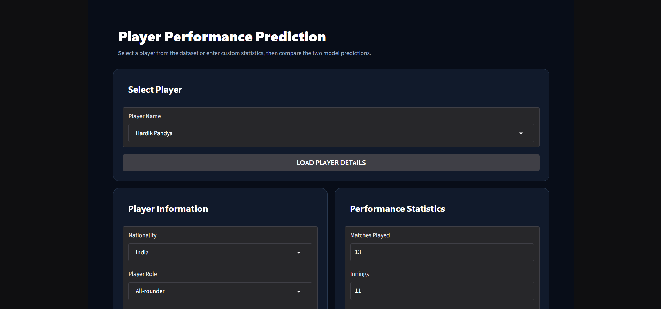
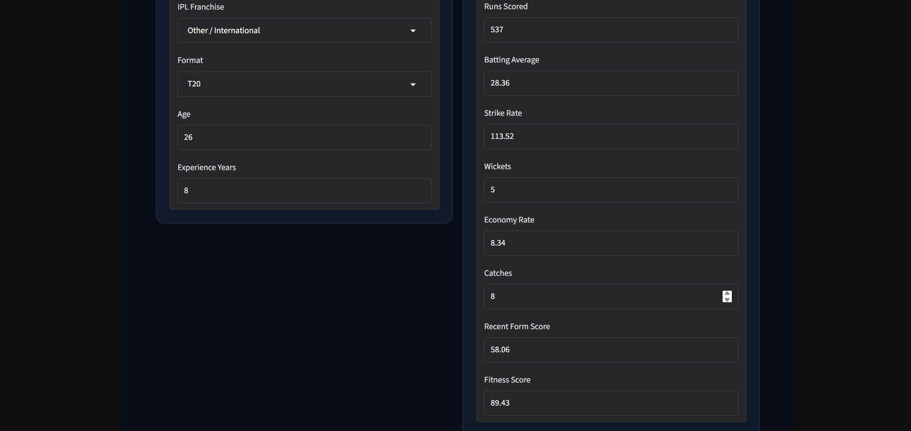
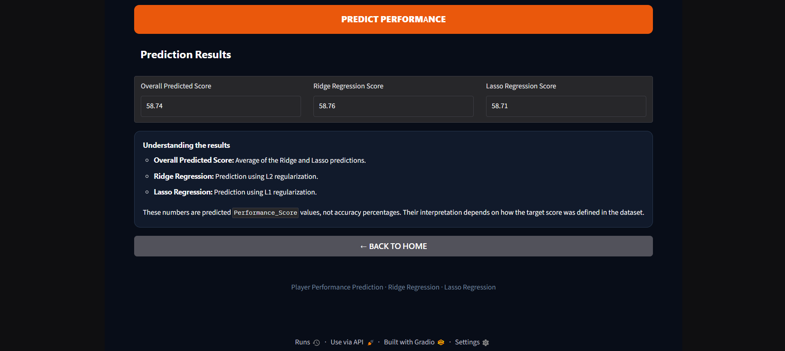
SCREENSHOTS / DEMO
Insert screenshot
Insert screenshot
Insert screenshot
Insert screenshot

Slide 24
ADVANTAGES
Reduces overfitting through regularization, so predictions on new data are more reliable.
Ridge handles correlated features (multicollinearity) well.
Lasso performs automatic feature selection and gives a simpler model.
Improvement over plain linear regression, which is unstable on many correlated features.
Fast to train and easy to interpret (coefficients show feature impact).
Objective, data-driven decisions instead of manual judgement.
Built with free, open-source tools (Python, Scikit-learn).

Slide 25
APPLICATIONS
Real-world applications:
Player selection and team building.
Predicting future match performance.
Planning training and workload.
Player valuation, auctions and contracts.
Fantasy sports team selection.
Target users / industries:
Coaches, team management and selectors.
Sports analytics companies and sports media.
Fantasy sports platforms.

Slide 26
LIMITATIONS
Current limitations:
Assumes a linear relationship between features and performance.
Does not consider match conditions such as pitch, opponent, weather or form.
Dataset / technical constraints:
Accuracy depends on the size and quality of the dataset.
Limited to the features available in the Kaggle dataset.
Lasso may drop one of two correlated useful features.
Results need to be validated on more datasets before real use.

Slide 27
FUTURE SCOPE
Possible improvements:
Use Elastic Net, Random Forest, Gradient Boosting or neural networks and compare.
Include more features: opponent, venue, recent form, fitness and injury data.
Additional features:
Web or mobile app where coaches enter player data and get a prediction.
Dashboard with graphs and player comparison.
Deployment / scaling:
Deploy on a cloud platform and update with live match data.
Extend to other sports.

Slide 28
CONCLUSION
What was achieved: We built a system that predicts player performance using Ridge and Lasso Regression on historical player statistics.
Data was cleaned, encoded and scaled, EDA was carried out, and both models were trained, tuned and evaluated using MAE, MSE, RMSE and R².
Key outcome: Regularization reduced overfitting, and Lasso helped identify the most important performance factors.
Overall contribution: The project shows that regularized regression can give coaches and analysts a simple, interpretable and data-driven tool for decisions.

Slide 29
THANK YOU

